Slide 1
Lincoln Financial Group
Cucumber and Selenium Mentoring
Notes:
Adam

Slide 2
Introduction
Instructor
Class Objective
Agenda
BDD & Cucumber Overview
Introduction to Selenium in Java
Implementing Cucumber Automation
Real World Automation - Q&A
Daily Schedule
Notes:
Objective:
To introduce the concept of behavior driven development along with a basic overview of selenium and cucumber in Java
We will start out with high level concepts and methodologies and then we will close PowerPoint, open our IDEs and write real automation code together as a team.
I know we have a mixed skill set in this group. Please feel free to ask questions (Including java questions) either over the phone or the chat feature of GoToMeeting.
These sessions will be recorded over the next 4 days and will be made available to your team afterwards.

Slide 3
What is BDD?
“BDD is a second-generation, outside-in, pull-based, multiple-stakeholder, multiple-scale, high-automation, agile methodology. It describes a cycle of interactions with well-defined outputs, resulting in the delivery of working, tested software that matters.” ~Dan North
Notes:
Adam

Slide 4
BDD Overview
BDD stands for Behavior Driven Development.
BDD is about collaboration and communication.
Good test automation is a side effect of BDD.
“Having conversations
Is more important than
capturing conversations
Is more important than
automating conversations”
~Liz Keogh

Slide 5
Behavior
Not about how you write test.
Not about words.
Not about tools.
It is about thinking how the software that you are creating behaves.

Slide 6
Driven
Driving development using the desired behavior.
Similar to driving software to meet the criteria of a test, but more involved.
Development is driven to meet how the software should behave for a customer, not just that it will pass a test.
Scenarios come before software, so that they can drive.

Slide 7
Development
Designing and Developing software to meet our stakeholders needs and wants.

Slide 8
TDD, a BDD Prerequisit
TDD
“BDD requires familiarity with a greater range of concepts than TDD does, and it seems difficult to recommend a novice programmer should first learn BDD without prior exposure to TDD concepts”’
TDD = Test Driven Development
Notes:
Adam

Slide 9
Benefits of TDD
Unit test proves that the code actually works
Can drive the design of the program
Refactoring allow to improve the design of the code
Low Level regression test suite
Test first reduce the cost of the bugs

Slide 10
Drawbacks of TDD
Developer can consider it as a waste of time
The test can be targeted on verification of classes and methods and not on what the code really should do
Test become part of the maintenance overhead of a project
Rewrite the test when requirements change

Slide 11
Extending and Improving TDD with BDD
BDD extends TDD by:
Writing tests in plain descriptive English.
Explaining tests as behaviors of the application, focusing more on the user
Using examples to clarify requirements

Slide 12
Benefits of BDD
Shifts team from ‘Test’ thinking to ‘Behavior’ thinking.
Collaboration between Business stakeholders, Business Analysts, QA Team and developers.
Universal language that is easy to describe.
Driven by Business Value.
Extends TDD by utilizing natural language that non technical stakeholders can understand.
BDD works with powerful frameworks such as Cucumber.

Slide 13
What BDD isn’t
BDD is NOT:
About the words Given, When, or Then
Just about testing and the testers
An alternative to manual testing.

Slide 14

What is
A testing framework which supports Behavior Driven Development (BDD). It lets us define application behavior in plain meaningful English text using a simple grammar defined by a language called Gherkin.
Notes:
Adam

Slide 15
Cucumber
Helps facilitate the for mentioned collaboration
Helps automate examples derived from user stories
Helps generate living documentation
Documentation that turns red and green.
Either you have found a defect, or your documentation is out of date.

Slide 16
More about Cucumber…
Features
Documentation about how a piece of our software will run.
Made up of Scenarios.
Scenarios
Made up of steps.
Small examples of how a feature will behave.
Include context.
Provide actions.
List expected outcomes.
Backgrounds
Prerequisite ‘Scenario like’ sets of steps
Steps
Written in a simple and ubiquitous language called Gherkin.

Slide 17
What is Gherkin?
Helps facilitate the discovery and use of a ubiquitous language within the team.
Notes:
Adam

Slide 18
Keywords
Given
First step
Precondition or Setup
When
General Action
Then
Assertion/Validation
And
Additional actions or assertions
Wildcards to the keyword above it
Notes:
Some people use ‘But’, but it is not advised.

Slide 19
Example
Feature: Refund item
Scenario: Jeff returns a faulty microwave
Given Jeff has bought a microwave for "100"
And he has a receipt
When he returns the microwave
Then Jeff should be refunded "100"

Slide 20
Gherkin Best Practices
Features, Scenarios, and Steps should be:
Independent of one another.
As descriptive as possible.
Unique.
Combine and parameterize similar steps
Keep modularity in mind when designing steps
Follow best standards for casing, indentations, etc.
Do not use tools like MSWord to write steps.

Slide 21
Cucumber and Gherkins Automation
Glue Code
Step Definitions
Code behind steps
How code can control an application
Web, services and beyond…
Application backend code does not matter.

Slide 22
Questions?
Notes:
Team

Slide 23


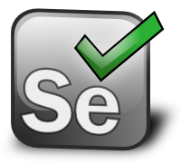

Next steps
Eclipse IDE
Maven
Selenium
Testing Frameworks
Cucumber Implementation
Page Object Model

Slide 24
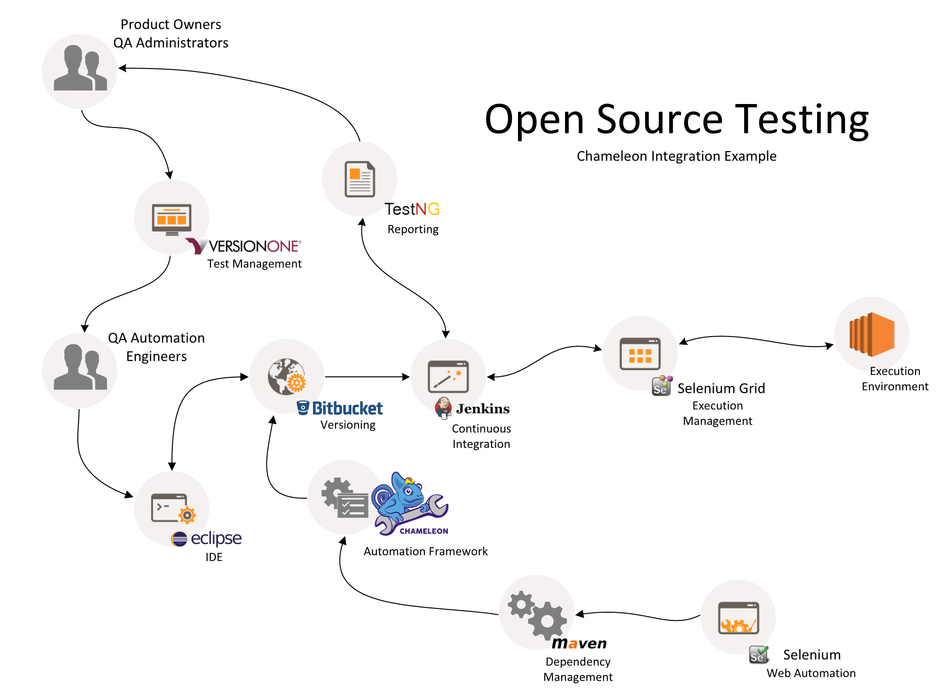

Slide 25
Sources
Agile Alliance
Dan North
Seb Rose
Glass BoxT
ToolsQA
Execute Automation

